Slide 1
GIT for Dummies

Slide 2
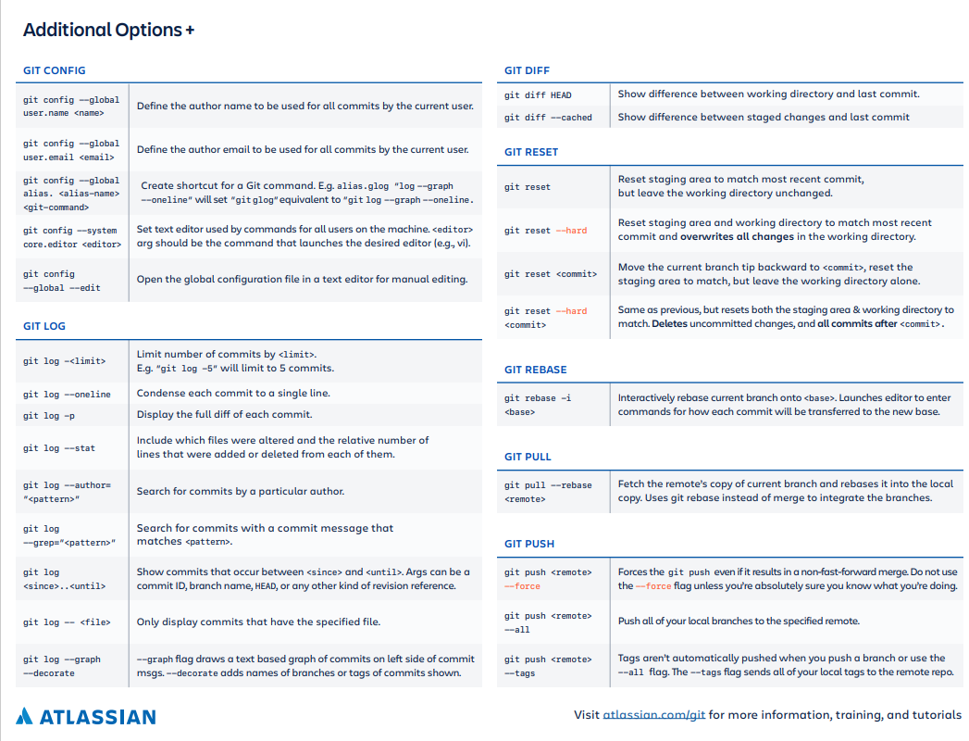
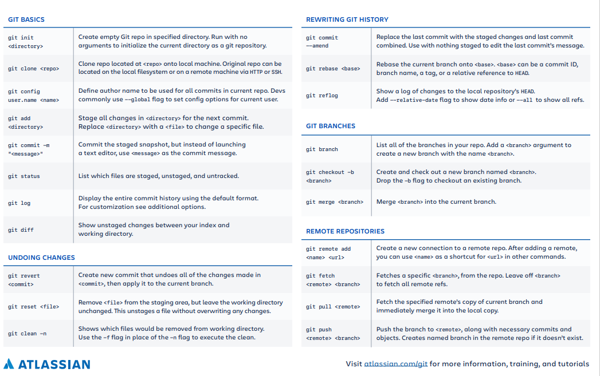
https://www.atlassian.com/git/tutorials/atlassian-git-cheatsheet

Slide 3

Software Version Management
Flera personer kan jobba med samma kodbas
Backup
Spårbarhet

Slide 4
Egen dator
Server
Local changes | Staged | Local commits | Remote commits

Slide 5
Egen dator
Server
Local changes | Staged | Local commits | Remote commits
Branches
master
>> git clone

Slide 6
Egen dator
Server
Local changes | Staged | Local commits | Remote commits
Branches
master
>> git diff

Slide 7
Egen dator
Server
Local changes | Staged | Local commits | Remote commits
Branches
master
>> git add

Slide 8
Egen dator
Server
Local changes | Staged | Local commits | Remote commits
Branches
master
>> git commit

Slide 9
Egen dator
Server
Local changes | Staged | Local commits | Remote commits
Branches
master
>> git push

Slide 10
Egen dator
Server
Local changes | Staged | Local commits | Remote commits
Branches
master
branch1
>> git branch

Slide 11
Egen dator
Server
Local changes | Staged | Local commits | Remote commits
Branches
master
branch1
>> git checkout branch1

Slide 12
Egen dator
Server
Local changes | Staged | Local commits | Remote commits
Branches
master
branch1
>> git add

Slide 13
Egen dator
Server
Local changes | Staged | Local commits | Remote commits
Branches
master
branch1
>> git commit

Slide 14
Egen dator
Server
Local changes | Staged | Local commits | Remote commits
Branches
master
branch1
>> git push

Slide 15
Egen dator
Server
Local changes | Staged | Local commits | Remote commits
Branches
master
branch1
>> git diff branch1 master

Slide 16
Egen dator
Server
Local changes | Staged | Local commits | Remote commits
Branches
master
branch1
>> git rebase branch1

Slide 17
Egen dator
Server
Local changes | Staged | Local commits | Remote commits
Branches
master
branch1
>> git push

Slide 18
git clone
SERVER
LOKALT

Slide 19
git add
SERVER
LOKALT

Slide 20
git commit
SERVER
LOKALT

Slide 21
git push
SERVER
LOKALT

Slide 22
git clone
BOB
SERVER
LOKALT

Slide 23
git pull
BOB
SERVER
LOKALT

Slide 24
git pull
BOB
SERVER
LOKALT

Slide 25
git pull
BOB
?
SERVER
LOKALT

Slide 26
git rebase
BOB
SERVER
LOKALT

Slide 27
git merge
BOB
SERVER
LOKALT

